Slide 1

Stock Price Prediction
Nishant Nayar
Johnson Bam
Notes:
Line spacing + Page numbers

Slide 2
Agenda
01 Introduction
02 Time-Series Price Prediction
03 Architecture
04 User Interface
05 What’s next

Slide 3



Team
Nishant
Johnson
nishant.nayar@hotmail.com
bam_johnson@yahoo.com

Slide 4

Introduction
01
Pairs Trading
A pairs trade is a trading strategy that involves matching a long position with a short position in two stocks with a high correlation.
Tax Loss Harvesting
Tax-loss harvesting is the timely selling of securities at a loss to offset the amount of capital gains tax owed from selling profitable assets.
Notes:
https://www.investopedia.com/terms/p/pairstrade.asp
https://www.investopedia.com/terms/t/taxgainlossharvesting.asp

Slide 5
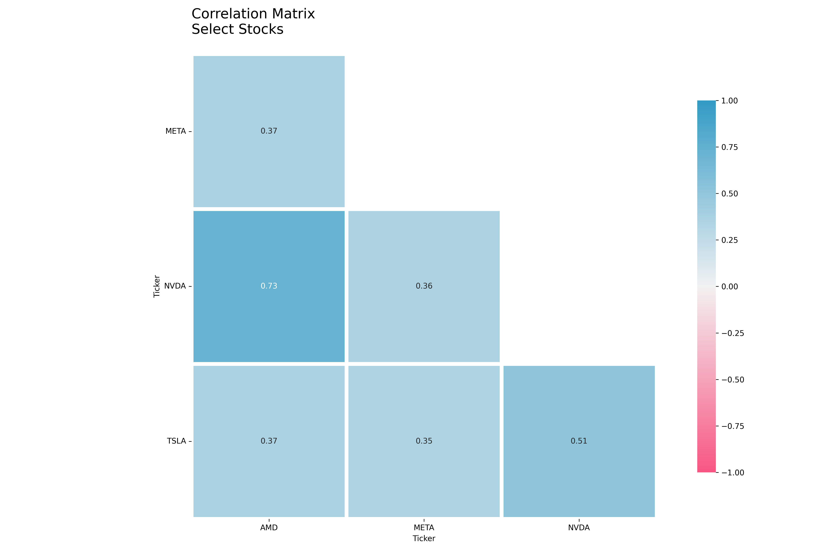
META and NVIDIA
Compared all the stocks in S&P 100 index. Using K-means clustering clustered into smaller groups and identified two correlated stocks
Why
Both Tech companies
Both have become synonymous with AI
NVIDIA – produces chips used in Generative AI.
META – is huge consumer of these chips and end users using META products also uses these chips
Notes:
https://www.cnn.com/2023/08/24/investing/nvidia-stock/index.html

Slide 6
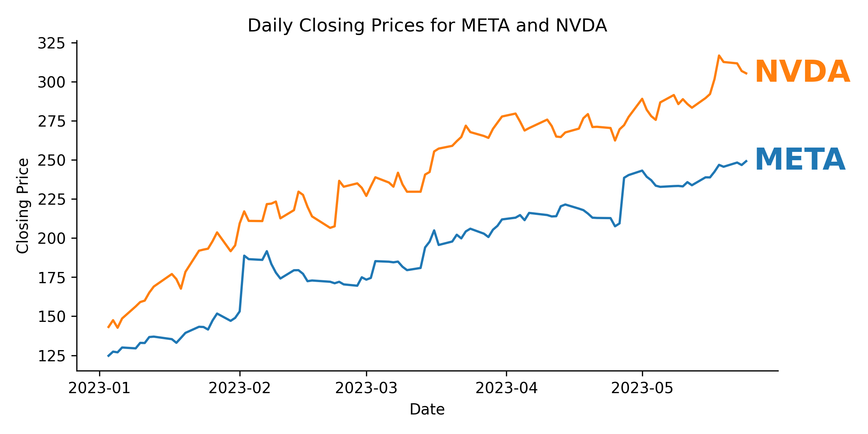
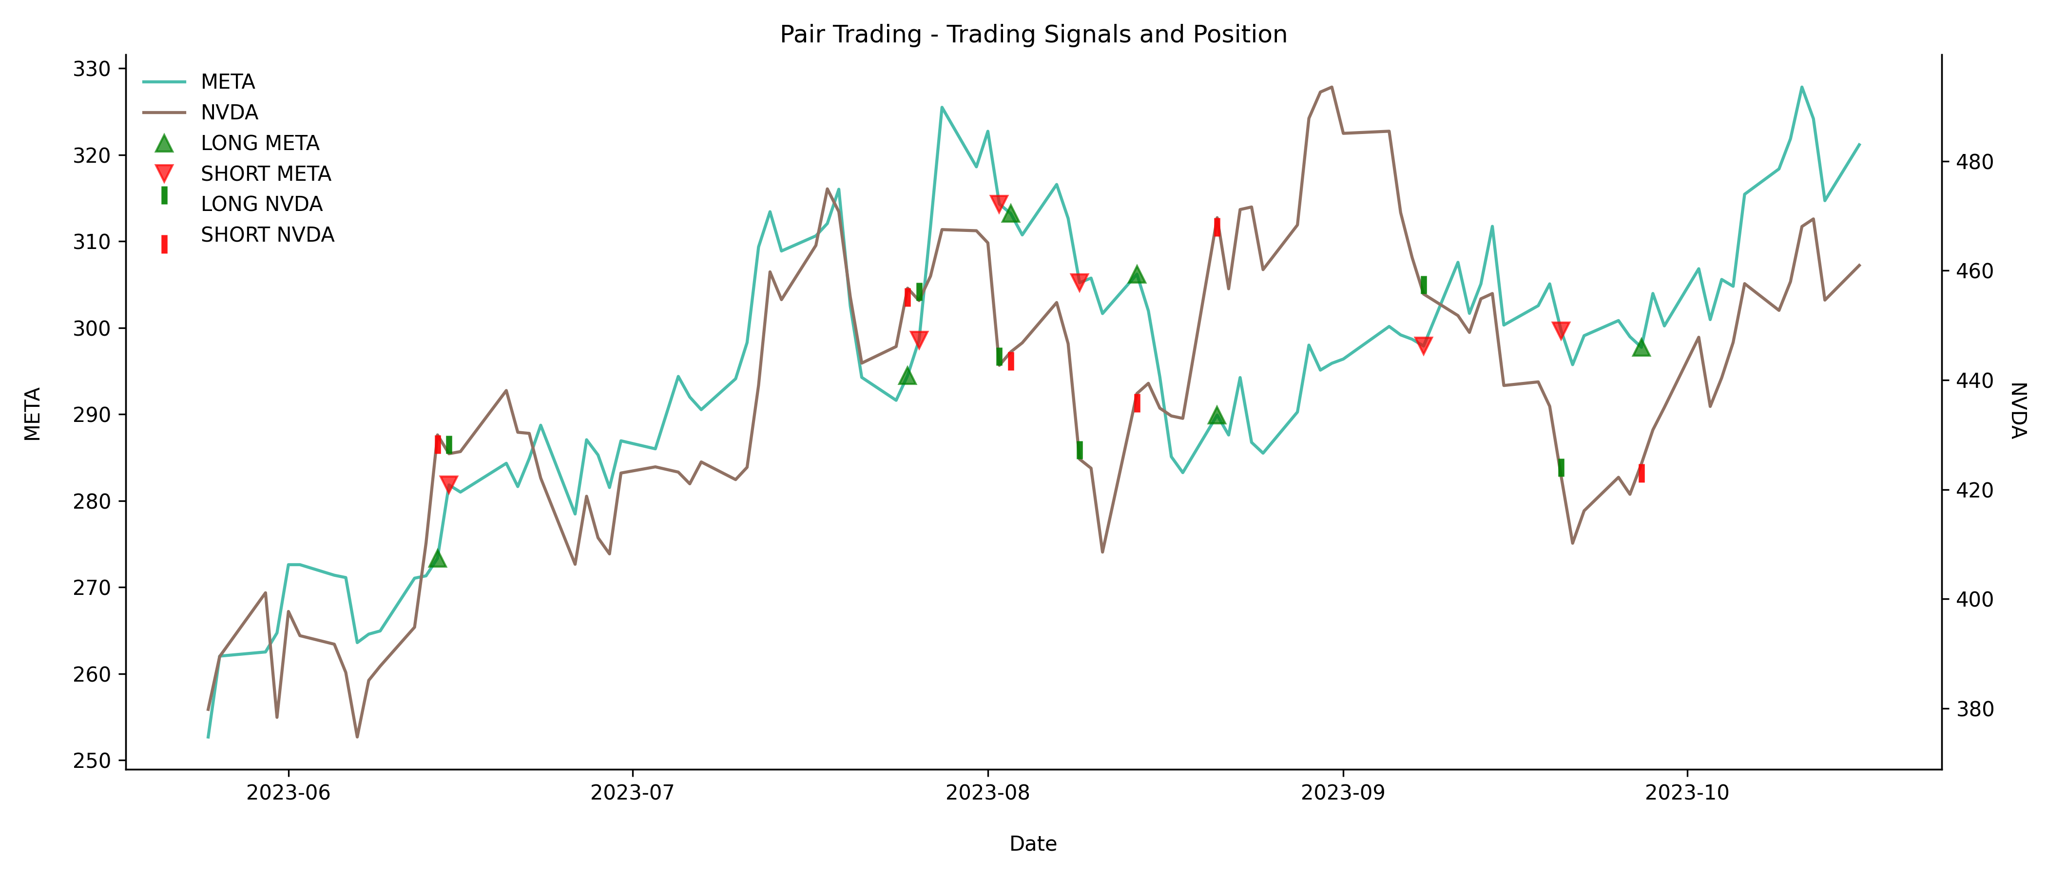
Pairs Trading Strategy
Simple pairs trading strategy between the two stocks yield promising results.
Advanced indication of a favorable price movement, along with tax loss harvesting from other open positions can help in smart investing
Further details in the ‘Analysis’ notebook

Slide 7
Time-Series Price prediction
02

Slide 8
Time-Series Price Prediction
Models
Stacked LSTM
ARIMA model
Data
every minute data from Alpaca
from Sept 1, 2023, to Oct 16, 2023
Selection Criteria
Time taken to run the model
(Laptop with GPU was used)
Incremental Learning
Time
LSTM – 20 Seconds
ARIMA – 3K Seconds
MSE
LSTM – 0.32
ARIMA – 0.13
Further details in the ‘TimeSeries Prediction’ notebook

Slide 9
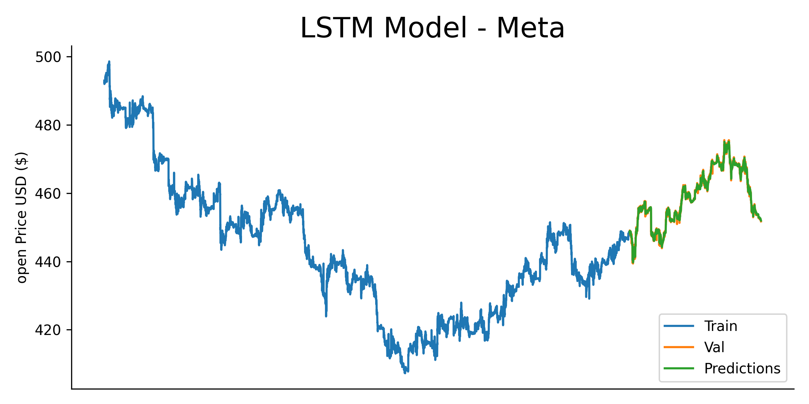
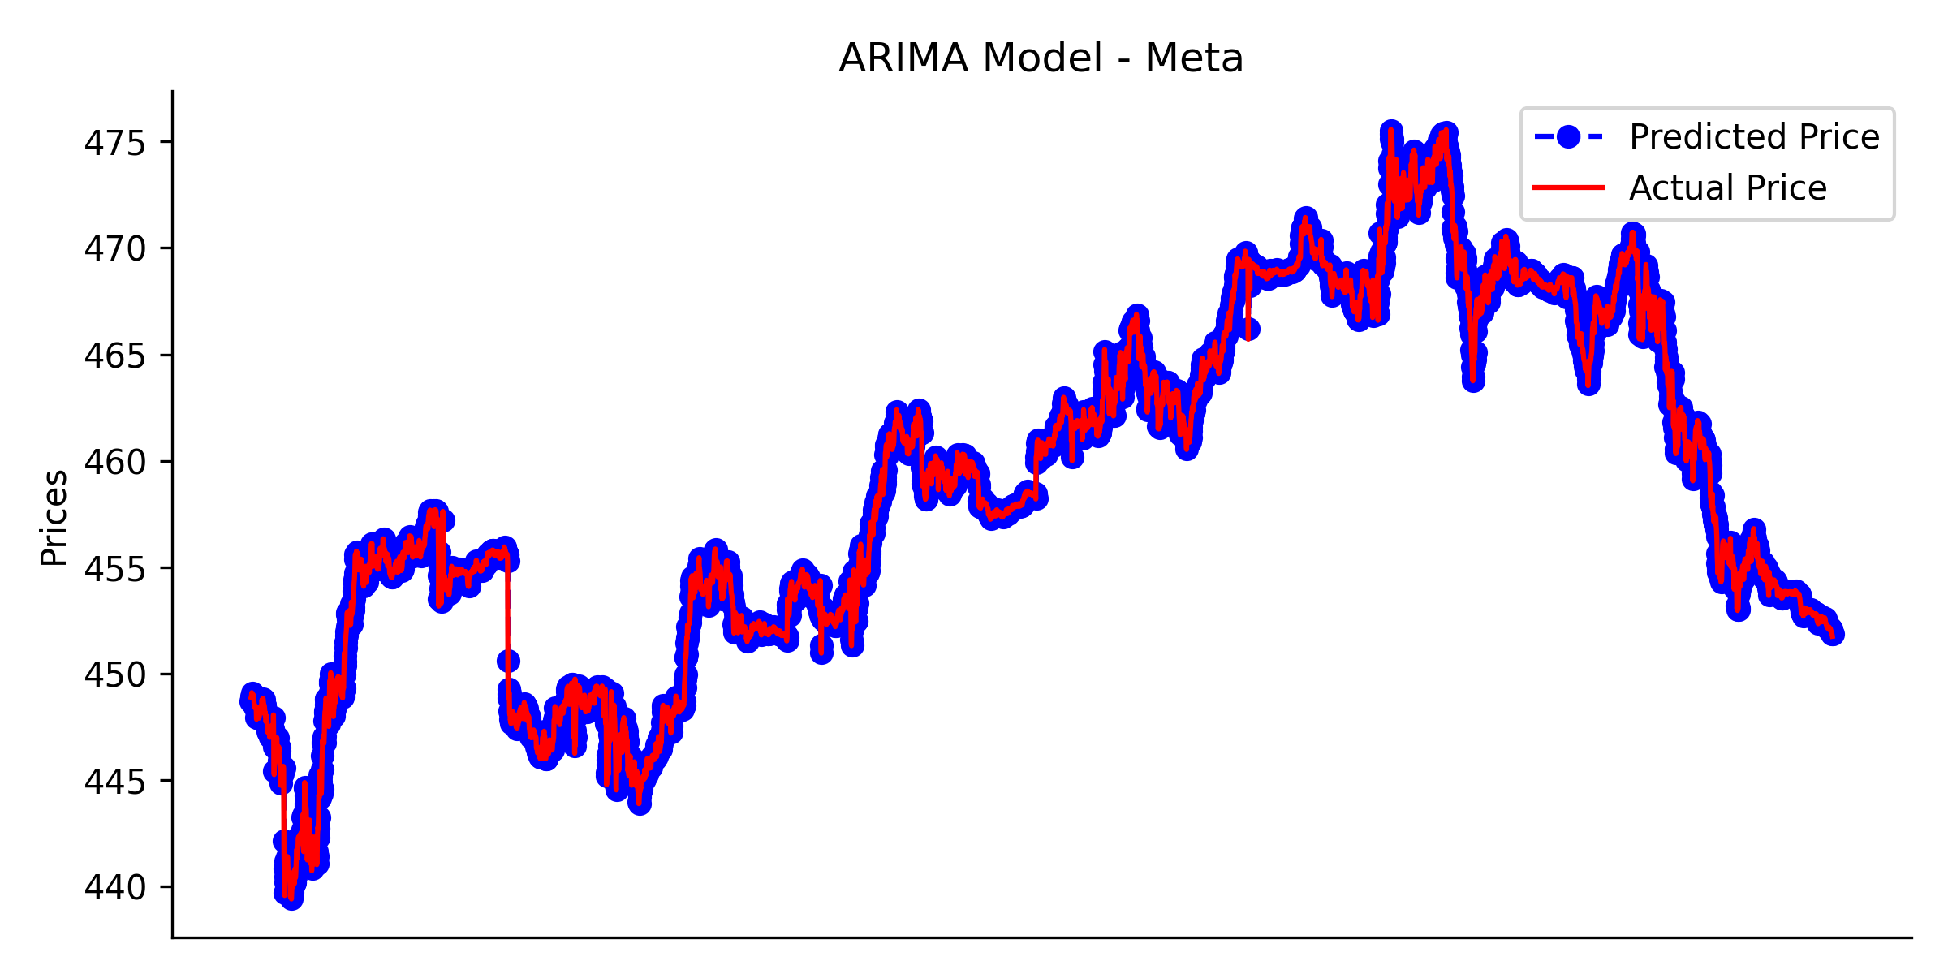
Time-Series Price Prediction
Further details in the ‘TimeSeries Prediction’ notebook

Slide 10
Architecture
03

Slide 11

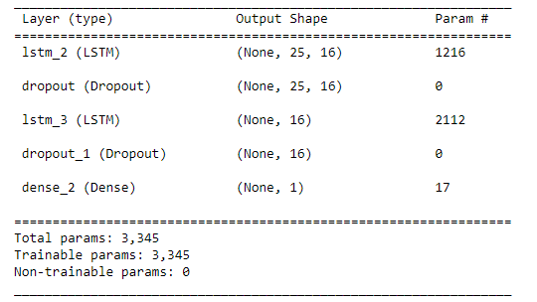
Interim Architecture
Websocket
Data Subscription
Predictions
Incremental Learning
User Interface
Streamlit
Finnhub
LSTM Model
Incremental data
Data Store
Nightly Model generation
LSTM Model
Alpaca Api
Historical Prices
LSTM Model and Scaler
Entire dataset
- Data quality of financial websites is good, no need for outlier detection
- Standard MinMax Scaler was used, was saved and same was used in incremental learning also

Slide 12
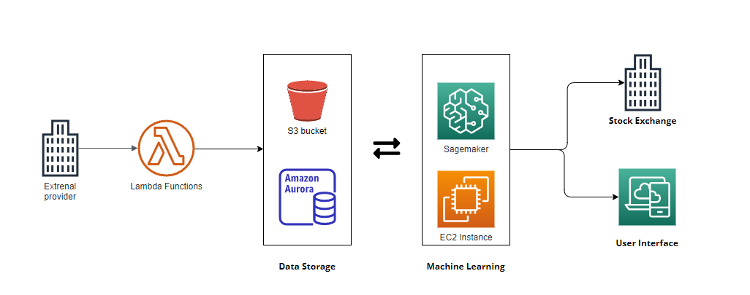
Future Architecture
Public cloud based for always – on and resiliency
Public cloud based for always – on and resiliency

Slide 13
User Interface
04

Slide 14
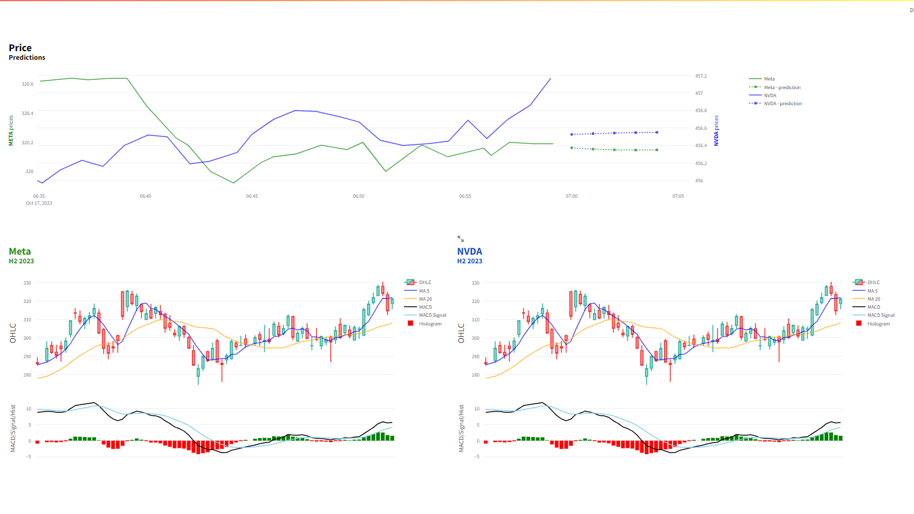

Slide 15
What’s next
05

Slide 16

Goals
Cloud
Use AWS or Google Pub/Sub for deployment
Always – On and Resiliency
Model Finetuning
Explore other models like LSTM with Attention and GANs
Handle spikes in data
Compare nightly and Incremental learning model performance
Data Sources
Pricing Data- sources
Connecting with Alpaca , Binance for trading

Slide 17
References
ChatGpt
https://link.springer.com/article/10.1007/s12530-022-09481-x#Fig2
https://pyimagesearch.com/2019/06/17/online-incremental-learning-with-keras-and-creme/
https://medium.com/the-handbook-of-coding-in-finance/stock-prices-prediction-using-long-short-term-memory-lstm-model-in-python-734dd1ed6827
https://cs230.stanford.edu/projects_winter_2020/reports/32066186.pdf
https://towardsdatascience.com/time-series-forecasting-predicting-stock-prices-using-an-arima-model-2e3b3080bd70
https://www.kaggle.com/code/kamyarazar/stock-price-prediction-lstm-hyperparameter-tuning

